Slide 1
Queues
Atique Zafar

Slide 2
INTRODUCTION
A queue is logically a first in first out (FIFO or first come first serve) linear data structure.
It is a homogeneous collection of elements in which new elements are added at one end called rear, and the existing elements are deleted from other end called front.
The basic operations that can be performed on queue are
  1. Insert (or add) an element to the queue (push)
  2. Delete (or remove) an element from a queue (pop)

Slide 3
PUSH AND POP OPERATION
Push operation will insert (or add) an element to queue, at the rear end, by incrementing the array index.
Pop operation will delete (or remove) from the front end by decrementing the array index and will assign the deleted value to a variable.

Slide 4
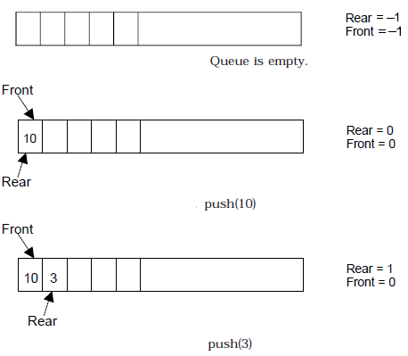
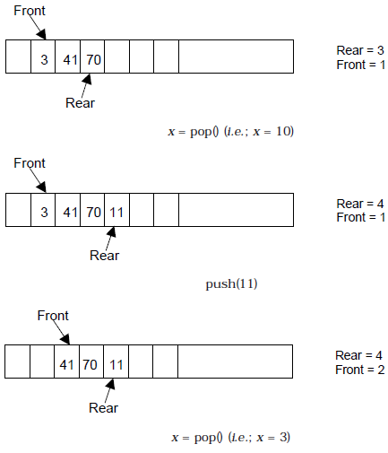
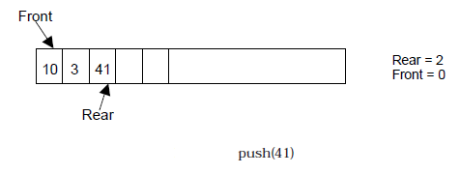
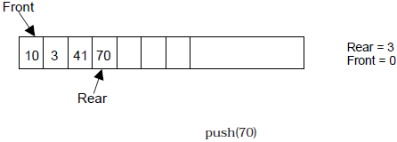
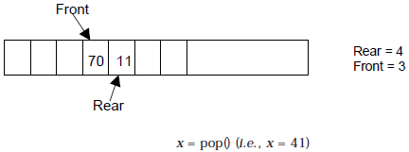
BASIC OPERATIONS ON QUEUE

Slide 5
IMPLEMENTATION OF QUEUE
Queue can be implemented in two ways:
  1. Using arrays (static)
  2. Using pointers (dynamic)
If we try to pop (or delete or remove) an element from queue when it is empty, underflow occurs.
If we try to push (or insert or add) an element to queue When queue is full, overflow occurs.
Total number of elements present in the queue is
  Rear – front + 1, when implemented using arrays.

Slide 6
ALGORITHM FOR QUEUE OPERATIONS
Let Q be the array of some specified size say SIZE
Inserting an element into the queue
  1. Initialize front=0 rear = –1
  2. Input the value to be inserted and assign to variable “data”
  3. If (rear >= SIZE)
  (a) Display “Queue overflow”
  (b) Exit
  4. Else
  (a) Rear = rear +1
  5. Q[rear] = data
  6. Exit

Slide 7
CODE TO INSERT ELEMENT IN THE QUEUE
void insert () //Note: Initially int rear = –1; int front = –1;
  {
  int added_item;
  if (rear==MAX-1)
  {
  cout<<“Queue Overflow”;
  getch();
  return;
  }
  else
  {
  if (front== –1) /*If queue is initially empty */
  front=0;
  cout<<“Input the element for adding in queue: ”;
  cin>>added_item;
  rear=rear+1;
  //Inserting the element
  queue_arr[rear] = added_item ;
  }
  }/*End of insert()*/

Slide 8
ALGORITHM FOR QUEUE OPERATIONS
Deleting an element from queue
  1. If (front==-1 II rear< front)
  (a) Display “The queue is empty”
  (b) Exit
  2. Else
  (a) Data = Q[front]
  3. front = front +1
  4. Exit

Slide 9
CODE TO DELETE AN ELEMENT FROM THE QUEUE
  void del()
  {
  if (front == –1 || front > rear)
  {
  cout<<“Queue Underflow”;
  return;
  }
  else
  {
  //deleting the element
  Cout<<“Element deleted from queue is :”<<queue_arr[front];
  front=front+1;
  }
  }/*End of del()*/

Slide 10
QUEUE USING LINKED LIST

Slide 11
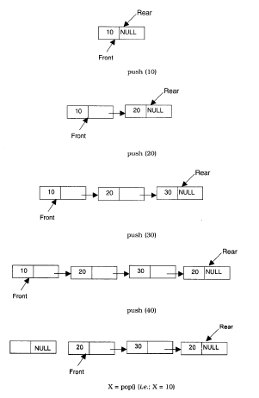
QUEUE USING LINKED LIST

Slide 12
ALGORITHM FOR PUSHING AN ELEMENT TO A QUEUE
REAR is a pointer in queue where the new elements are added.
FRONT is a pointer, which is pointing to the queue where the elements are popped.
DATA is an element to be pushed.
1. Input the DATA element to be pushed
2. Create a New Node
3. NewNode → DATA = DATA
4. NewNode → Next = NULL
5. If(REAR not equal to NULL)
(a) REAR → next = NewNode;
6. REAR =NewNode;
7. Exit

Slide 13
ALGORITHM FOR POPPING AN ELEMENT FROM A QUEUE
1. If (FRONT is equal to NULL)
(a) Display “The Queue is empty”
2. Else
(a) Display “The popped element is FRONT → DATA”
(b) If(FRONT is not equal to REAR)
(i) FRONT = FRONT → Next
(c) Else
(d) FRONT = NULL;
3. Exit

Slide 14
Function to push an element into the queue
void Queue_Linked::push()
{
  NODE *NewNode;
  NewNode= new NODE;//New node is created to push the data
  cout<<“\nEnter the no to be pushed = ”;
  cin>>NewNode->info;
  NewNode->next=NULL;
  //setting the rear pointer
  if (rear != NULL)
    rear->next = NewNode;
    rear=NewNode;
  else
    front = NewNode;
    Rear=NewNode
}

Slide 15
Function to pop the element from the queue
void Queue_Linked::pop()
{
if (front == NULL) //The Queue is empty when the front pointer is NULL
{
  cout<<“\nThe Queue is empty”;
  rear = NULL;
}
else
{
cout<<“\nThe popped element is = ”<<front->info;
if (front != rear)
front=front->next;
else
front = NULL; // only one node exists
}
}

Slide 16
TYPES OF QUEUES

Slide 17
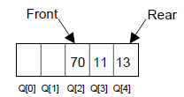
OTHER QUEUES
Suppose a queue Q has maximum size 5, say 5 elements pushed and 2 elements popped.
There are three major variations in a simple queue.
  1. Circular queue
  2. Double ended queue (de-queue)
  3. Priority queue
Priority queue is generally implemented using linked list so we discussed it later.

Slide 18
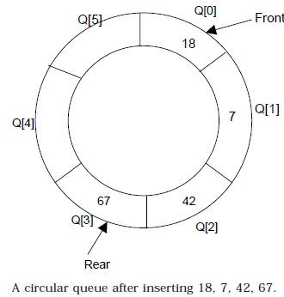
CIRCULAR QUEUE
In circular queues the elements Q[0],Q[1],Q[2] .... Q[n – 1] is represented in a circular fashion with Q[1] following Q[n].
A circular queue is one in which the insertion of a new element is done at the very first location of the queue if the last location at the queue is full.
Suppose Q is a queue array of 6 elements.
Push and pop operation can be performed on circular.

Slide 19
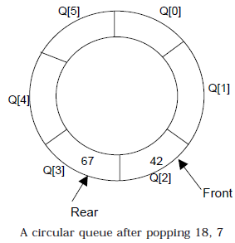
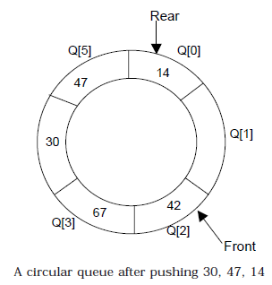
Cont…..
After inserting an element at last location Q[5], the next element will be inserted at the very first location (i.e., Q[0]).
Circular queue is one in which the first element comes just after the last element.

Slide 20
Cont……
At any time the position of the element to be inserted will be calculated by the relation
Rear = (Rear + 1) % SIZE
After deleting an element from circular queue the position of the front end is calculated by the relation
Front= (Front + 1) % SIZE
After locating the position of the new element to be inserted, rear, compare it with front.
  If (rear = front), the queue is full and cannot be inserted anymore.

Slide 21
ALGORITHMS
Inserting an element to circular Queue
  1. Initialize FRONT = – 1; REAR = -1
  2. REAR = (REAR + 1) % SIZE
  3. If (FRONT is equal to REAR)
    (a) Display “Queue is full”
    (b) Exit
  4. Else
    (a) Input the value to be inserted and assign to variable “DATA”
  5. If (FRONT is equal to – 1)
    (a) FRONT = 0
    (b) REAR = 0
  6. Q[REAR] = DATA
  7. Repeat steps 2 to 5 if we want to insert more elements
  8. Exit

Slide 22
Cont…
Deleting an element from a circular queue
  1. If (FRONT is equal to – 1)
    (a) Display “Queue is empty”
    (b) Exit
  2. Else
    (a) DATA = Q[FRONT]
  3. If (REAR is equal to FRONT)
    (a) FRONT = –1
    (b) REAR = –1
  4. Else
    (a) FRONT = (FRONT +1) % SIZE
  5. Exit

Slide 23
Circular Queue using Linked List
A Circular Queue is similar to a queue, but the last node's next pointer points back to the front instead of NULL.
This ensures efficient space utilization.
Operations
  Enqueue (Insert at Rear)
    Create a new node.
    If the queue is empty,
      set front and rear to the new node, and make rear->next = front.
    Otherwise, link the rear to the new node, update rear, and set rear->next = front.
  Dequeue (Delete from Front)
    If empty, return.
    If only one node exists, delete it and set front = rear = NULL.
    Otherwise, move front to the next node and update rear->next = front.

Slide 24
APPLICATION OF CIRCULAR QUEUE

Slide 25
ROUND-ROBIN SCHEDULING
Circular queues play a role in implementing round-robin scheduling algorithms for CPU or process management.
Processes are added to the queue and serviced in a circular fashion based on a time slice.
Example:
  Operating systems can use circular queues to allocate CPU time to multiple processes fairly, ensuring each process gets a chance to run.

Slide 26
CONCEPT
Imagine a round-robin, where each person gets a turn to hold it for a short period before passing it on to the next person in a circular fashion.
CPU scheduling applies this concept to processes.
Example:
Consider three processes: P1, P2, and P3, with different burst times (amount of CPU time needed):
    Process Burst Time
    P1 4 units
    P2 2 units
    P3 3 units

Slide 27
Time Quantum
A fixed time slice, called a time quantum (TQ), is defined.
This determines how long a process gets to run before being preempted (interrupted) and placed back in a waiting queue.
Let's assume a time quantum of 2 units for this example.

Slide 28
Scheduling Process
Initial Queue: The processes are placed in a ready queue (waiting to be executed) in a first-come, first-served (FCFS) manner:
P1 -> P2 -> P3.
Process P1:
  P1 starts execution and runs for its time quantum (2 units). Since its burst time is not yet complete (4 units), it's preempted and added back to the end of the ready queue.
  Ready Queue after P1: P2 -> P3 -> P1.
Process P2:
  P2 starts execution. It finishes its entire burst time (2 units) within the time quantum. P2 is considered finished and removed from the queue.
Ready Queue after P2: P3 -> P1.
Process P3:
  P3 starts execution. It runs for its time quantum (2 units). However, its burst time (3 units) is not yet complete. It's preempted and added back to the end of the ready queue.
Ready Queue after P3: P1 -> P3.
Process Scheduling Continues:
  The process of preempting after the time quantum and placing processes back in the queue based on their remaining burst time continues until all processes finish execution.

Slide 29
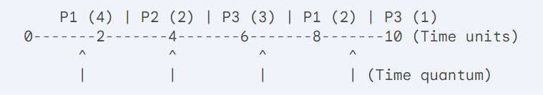
Visualization (Gantt Chart):

Slide 30
Key Points
Processes take turns running for a limited time quantum.
Processes are preempted even if their burst time isn't complete.
This ensures all processes get a chance to run and prevents starvation (a process waiting indefinitely).
The time quantum value impacts how responsive the system feels to users (lower TQ leads to faster context switching and potentially better user experience).

Slide 31
Applications
Round-robin scheduling is commonly used in:
  Operating systems for handling multiple user processes
  Interactive systems where fast response times are crucial
  Network routers for fair allocation of bandwidth to data packets

Slide 32
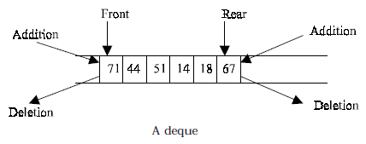
DEQUES
A deque is a homogeneous list in which elements can be added or inserted and deleted or removed from both the ends.
  We can add a new element at the rear or front end and also we can remove an element from both front and rear end.
Hence it is called Double Ended Queue.

Slide 33
Cont….
There are two types of deque depending upon the restriction to perform insertion or deletion operations at the two ends.
  1. Input restricted deque
  2. Output restricted deque
An input restricted deque
  is a deque, which allows insertion at only 1 end, rear end,
  but allows deletion at both ends, rear and front end of the lists.
An output-restricted deque
  is a deque, which allows deletion at only one end, front end,
  but allows insertion at both ends, rear and front ends, of the lists.

Slide 34
The possible operation performed on deque
  1. Add an element at the rear end
  2. Add an element at the front end
  3. Delete an element from the front end
  4. Delete an element from the rear end
Only 1st, 3rd and 4th operations are performed by input-restricted deque
1st, 2nd and 3rd operations are performed by output-restricted deque.

Slide 35
ALGORITHUM
Let Q be the array of MAX elements. front (or left) and rear (or right) are two array index (pointers), where the addition and deletion of elements occurred. Let DATA be the element to be inserted. Before inserting any element to the queue left and right pointer will point to the – 1.
INSERT AN ELEMENT AT THE RIGHT SIDE OF THE DE-QUEUE
  1. Input the DATA to be inserted
  2. If ((left == 0 && right == MAX–1) || (left == right + 1))
  (a) Display “Queue Overflow”
  (b) Exit
  3. If (left == –1) // if queue is initially empty
  (a) left = 0
  (b) right = 0
  4. Else
  (a) if (right == MAX –1)// right is at last position of queue
  (i) right = 0
  (b) else
  (i) right = right+1
  5. Q[right] = DATA
  6. Exit

Slide 36
Cont….
INSERT AN ELEMENT AT THE LEFT SIDE OF THE DE-QUEUE
  1. Input the DATA to be inserted
  2. If ((left == 0 && right == MAX–1) || (left == right+1))
  (a) Display “Queue Overflow”
  (b) Exit
  3. If (left == – 1)
  (a) Left = 0
  (b) Right = 0
  4. Else
  (a) if (left == 0)
  (i) left = MAX – 1
  (b) else
  (i) left = left – 1
  5. Q[left] = DATA
  6. Exit

Slide 37
ALGORITHMS FOR DELETING AN ELEMENT
Let Q be the array of MAX elements.
  front (or left) and rear (or right) are two array index (pointers), where the addition and deletion of elements occurred.
  DATA will contain the element just deleted.

Slide 38
Cont….
DELETE AN ELEMENT FROM THE RIGHT SIDE OF THE DE-QUEUE
  1. If (left == – 1)
    (a) Display “Queue Underflow”
    (b) Exit
  2. DATA = Q [right]
  3. If (left == right) //queue has only one element
    (a) left = – 1
    (b) right = – 1
  4. Else
    (a) if(right == 0)
      (i) right = MAX-1
    (b) else
      (i) right = right-1
  5. Exit

Slide 39
Cont…..
DELETE AN ELEMENT FROM THE LEFT SIDE OF THE DE-QUEUE
1. If (left == – 1)
  (a) Display “Queue Underflow”
  (b) Exit
2. DATA = Q [left]
3. If(left == right)
  (a) left = – 1
  (b) right = – 1
4. Else
  (a) if (left == MAX-1)
    (i) left = 0
  (b) Else
    (i) left = left +1
5. Exit

Slide 40
Does a Deque Follow FIFO?
FIFO is retained if:
  Insert at rear (pushRear()).
  Remove from front (popFront()).
  Behaves like a queue.
FIFO is NOT retained if:
  Insert at front and remove from rear (LIFO behavior).
  Random insertions and deletions from both ends.

Slide 41
Deque (Double-Ended Queue) using Linked List
A Deque (Double-ended Queue) allows insertion and deletion from both ends.
Operations
  Insert Front: Add a node at the front.
  Insert Rear: Add a node at the rear.
  Delete Front: Remove a node from the front.
  Delete Rear: Remove a node from the rear.

Slide 42
Final Summary
Data Structure | Insertion | Deletion | Special Features
Queue (Linked List) | Rear (O(1)) | Front (O(1)) | FIFO maintained
Circular Queue (LL) | Rear (O(1)) | Front (O(1)) | Rear connects to Front
Deque (LL) | Both Ends (O(1)) | Both Ends (O(1)) | Supports double-ended operations

Slide 43
DLL is Better than SLL for Deque!

Slide 44
Applications
Dequeues are used in various scenarios where efficient insertion and removal from both ends are needed:
  Browser history: Browsers often use dequeues to manage the back/forward history, allowing users to navigate efficiently between previously visited pages.
  Text editing: Dequeues can be used to implement undo/redo functionality in text editors, where users can reverse or redo recent actions.
  Caching: Caching systems might use dequeues to manage cached items, with newer items added at the back and least recently used items removed from the front to maintain a limited cache size.
  Multitasking: Operating systems can employ dequeues for task scheduling, allowing processes to be added or removed from the running queue dynamically.
  Graph algorithms: Some graph algorithms utilize dequeues to explore paths or perform topological sorting.

